Slide 1


“ GROcery store ”
"Fresh Picks, Fast Delivery – Your One-Stop Online Grocery Store!"
By Batch-04
231FA04283-Avanthika .v
231FA04381-Chandana.J
231FA04431-Mohana Venkata Krishna
231FA04548-Dharani.G

Slide 2
INTRODUCTION:
At our store, we bring fresh, high-quality groceries right to your doorstep with just a few clicks. Our mission is to make grocery shopping easy, convenient, and hassle-free. Whether you're looking for farm-fresh produce, pantry essentials, dairy products, or household items, we've got you covered.
With a user-friendly interface, secure payment options, and fast delivery, we ensure a seamless shopping experience. Browse through our wide range of products, add them to your cart, and get them delivered at your convenience.

Slide 3
PROBLEM STATEMENT:
Develop a web-based online grocery store that allows users to browse, search, and purchase grocery items seamlessly. The platform should be user-friendly, responsive across devices, and provide essential features such as product categorization, cart management, secure checkout, and order tracking. The challenge lies in integrating HTML, CSS, and JavaScript to create a smooth and customizable shopping experience for users.

Slide 4
EXISISTING SYSTEM:
PROPOSED SYSTEM:
(Traditional Grocery Shopping)
Customers visit physical stores for grocery shopping.
Requires time and effort to search for items.
Prone to product unavailability and long checkout queues.
Limited working hours and geographical constraints.
No personalized recommendations or order tracking.
Provides a digital platform for customers to browse and buy groceries.
Eliminates the need for physical visits, saving time and effort.
Ensures real-time inventory updates to prevent unavailability issues.
Offers home delivery, reducing travel and waiting time
Provides personalized recommendations and secure payment options.

Slide 5
Literature Review:
The rise of online grocery shopping has been a significant trend in recent years, driven by technological advancements, shifting consumer preferences, and the increasing demand for convenience. This literature review aims to provide a comprehensive overview of existing research on online grocery stores, examining various facets such as consumer behavior, business models, technological innovations, challenges, and the impact of online grocery shopping on the traditional retail market.
1. Consumer Behavior and Preferences
Studies indicate that convenience is the primary motivator for consumers to shop for groceries online. According to a study by Kumar et al. (2020), time-saving, avoiding long queues, and the ability to shop from home are key factors that influence consumer adoption of online grocery shopping. Moreover, Sharma et al. (2019) highlight the increasing preference for online platforms due to factors like personalized recommendations and the availability of a wider variety of products compared to physical stores.

Slide 6
System Requirements:
Frontend:
HTML, CSS, JavaScript
UI Design (Figma, Sketch)
Responsive (Bootstrap)
Backend:
Languages (Python, PHP, Node.js, Java)
Databases (MySQL, PostgreSQL, MongoDB)
Server (Apache, Nginx)
Payment Gateway:
Stripe, PayPal, Razorpay
Security:
SSL, 2FA, Encryption
Hardware & Software Requirements
Hardware
Web Servers – To host the website and handle incoming traffic.
Database Servers – For storing and managing product data, customer information, orders, etc.
Storage – Sufficient storage for product images, videos, and backups.
Backup Systems – To ensure data redundancy and protection against data loss.
Load Balancers – To distribute traffic efficiently across multiple servers.

Slide 7
Short Software Requirements Specification (SRS) for E-Commerce Website
1. Introduction
Purpose
This document outlines the software requirements for an e-commerce website, focusing on user-friendly shopping, secure transactions, and efficient management.
2. Overall Description
Product Functions
User Management: Registration, login, profile management.
Product Management: Browse, search, filter products.
Shopping Cart: Add/remove items, update quantities.
Order Management: Checkout, order tracking.
Payment Integration: Support multiple payment methods.
Admin Dashboard: Manage products, users, and orders.
Constraints
Comply with GDPR and PCI DSS.
Support up to 10,000 concurrent users.
3. Specific Requirements
Functional Requirements
Secure user authentication.
Product search and filters by category, price, and ratings.
Smooth checkout with order confirmation.
Non-Functional Requirements
Load pages within 2 seconds.
Ensure 99.9% uptime.
Use SSL for secure data transmission.
4. External Interfaces
User-friendly, responsive UI.
Integrate with payment gateways (e.g., Stripe, PayPal).

Slide 8
System Designs
Architecture
Frontend: Built using React or Angular for a responsive and interactive user interface.
Backend: Node.js or Django for handling business logic and API integration.
Database:Relational (MySQL/PostgreSQL) for structured data (products, orders, users).NoSQL (MongoDB) for unstructured data (logs, analytics).
Hosting: Cloud-based (AWS, Azure) with auto-scaling and load balancing.
2. Key Components
User Management
Authentication via JWT or OAuth.
Secure password storage using hashing (e.g., bcrypt).
Product Management
Product catalog stored in the database with indexing for search.
Search and filter features implemented using Elasticsearch
Shopping Cart
Session-based cart for guests.
Persistent cart for logged-in users using database storage.
Order Management
Multi-step checkout process.
Order tracking with status updates.
Payment Gateway
Integration with Stripe, PayPal, or Razorpay for secure transactions
Admin Panel
Dashboard for managing products, orders, and users.
Analytics visualization using libraries like Chart.js or D3.js.

Slide 9
Security
Modules of System
User Module: Registration, login, profile management, role-based access.
Product Management: CRUD for products, catalog browsing, search, and filters.
Shopping Cart: Add/remove items, update quantities, save cart.
Order Management: Place orders, track orders, view history, generate invoices.
Payment Integration: Secure payment gateways, refunds, transaction history.
Shipping: Real-time shipping cost, tracking via APIs.
Admin Dashboard: Manage users, products, orders, and view analytics.
Notifications: Email/SMS alerts for orders and updates.
Use HTTPS for secure communication.
Implement firewalls and regular vulnerability scanning.
Protect against SQL injection, XSS, and CSRF attacks.
High-Level Diagram
[Client Devices]
|
[Load Balancer]
|
[Application Servers]
|
[Database + Cache]
|
[Payment Gateway, CDN, Search, Shipping APIs]

Slide 10
UML Diagrams
Use Case Diagram (Textual Representation)
Actors:
Customer: The user who shops at the online grocery store.
Admin: The person who manages the inventory, orders, and overall store.
Payment System: External system to process payments.
Use Cases:
Browse Products: Customers can view available products.
Add to Cart: Customers can add items to their shopping cart.
Place Order: After selecting products, customers can place an order.
Make Payment: Customers can complete their purchase through a payment system.
View Order History: Customers can view past orders.
Search Products: Customers can search for specific products.
Manage Inventory: Admin can add or remove products from the inventory.
Process Orders: Admin can process and dispatch orders.
Manage Users: Admin can manage customer accounts.
Track Payment: Payment system processes payment and informs the system of status.

Slide 11
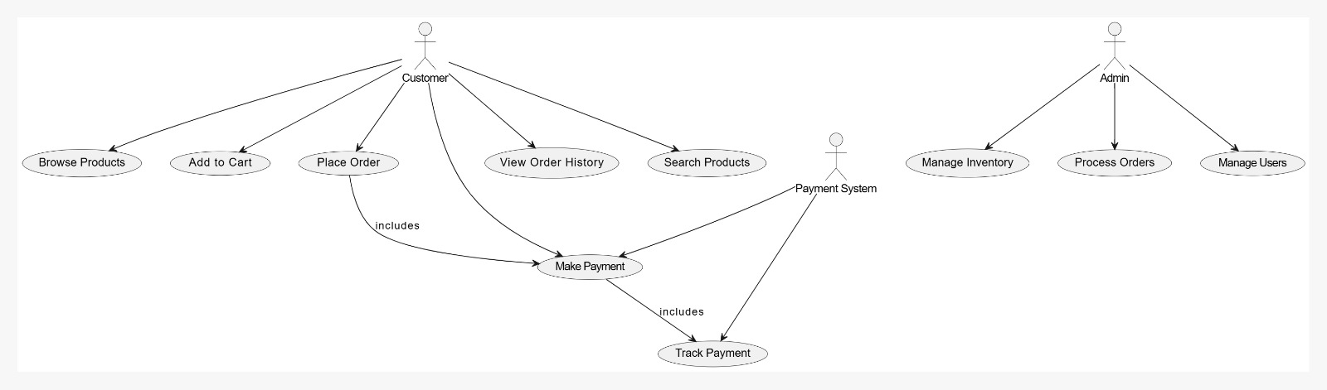

Slide 12
Implementation
Technology Stack
Frontend:
Languages: HTML, CSS, JavaScript.
Frameworks: React.js, Angular, or Vue.js.
Features:
Responsive design for mobile and desktop.
User-friendly navigation for browsing and searching products.
Backend:
Languages: Node.js, Python (Django/Flask), Java (Spring Boot), or Ruby on Rails.
Features:
RESTful APIs for data handling.
Business logic for cart, orders, and payments.
Database:
Relational Databases: MySQL, PostgreSQL.
NoSQL Databases: MongoDB (for flexibility in product catalog).
Features:
Data storage for users, products, orders, and transactions.
Optimization for search and filtering.
Hosting:
Cloud Providers: AWS, Google Cloud, Azure.
Services: Load balancers, auto-scaling, CDN (e.g., Cloudflare).

Slide 13
Sample Code
<!DOCTYPE html>
<html>
<head>
const username = document.getElementById("username").value;
const password = document.getElementById("password").value;
const errorMessage = document.getElementById("error-message");
if (validUsers[username] && validUsers[username] === password) {
alert("Login successful!");
// Hide the login section and directly go to the shopping section
document.getElementById("sectionusername").style.display = "none";
document.getElementById("sectionwelcomecontainer").style.display = "none";
document.getElementById("sectionitems").style.display = "block";
} else {
errorMessage.style.display = "block";
}
}
</script>

Slide 14
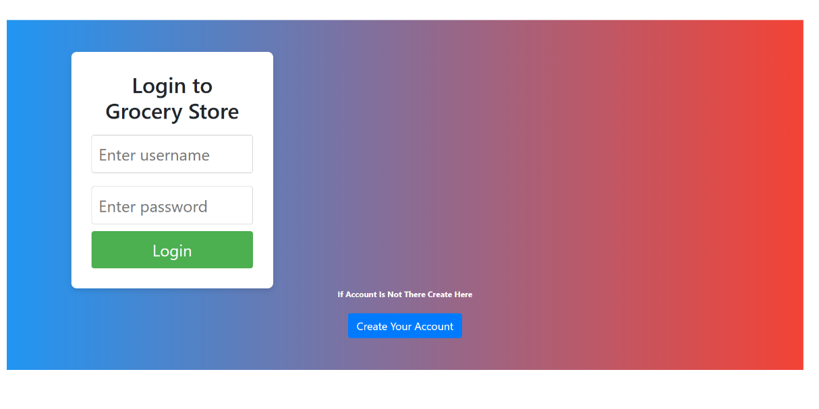
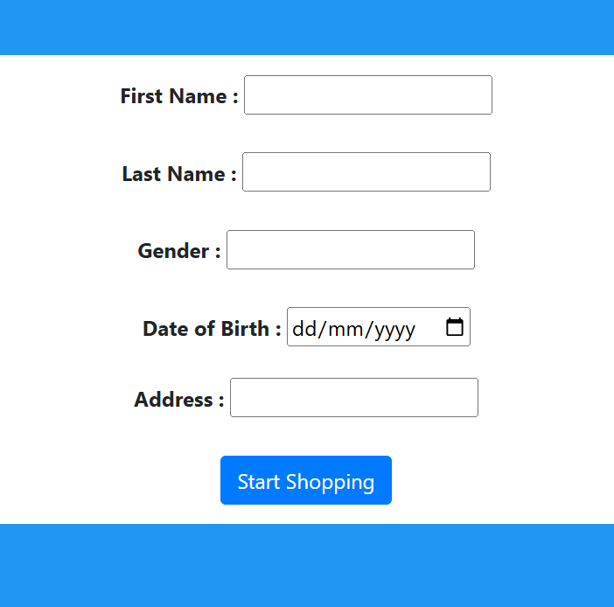
Results
Output Screens

Slide 15
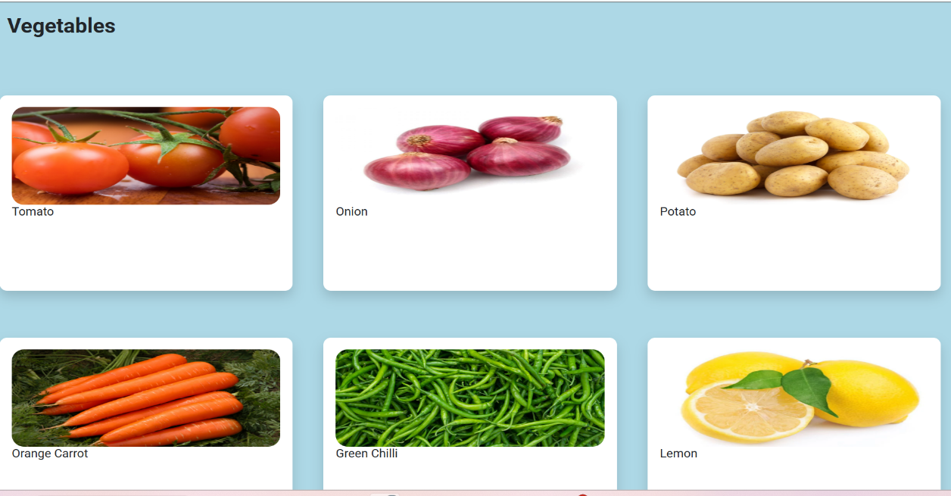
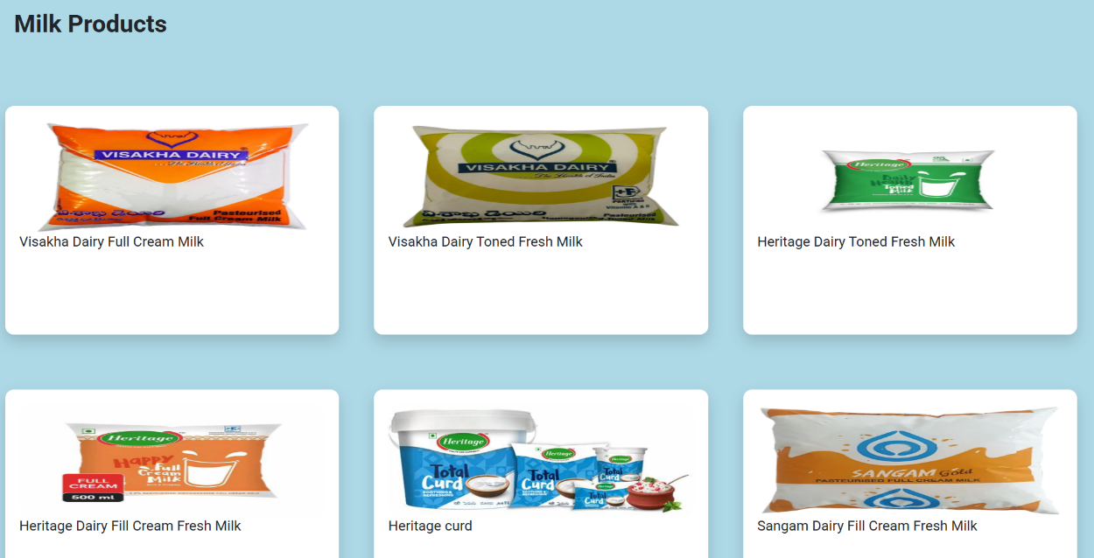

Slide 16
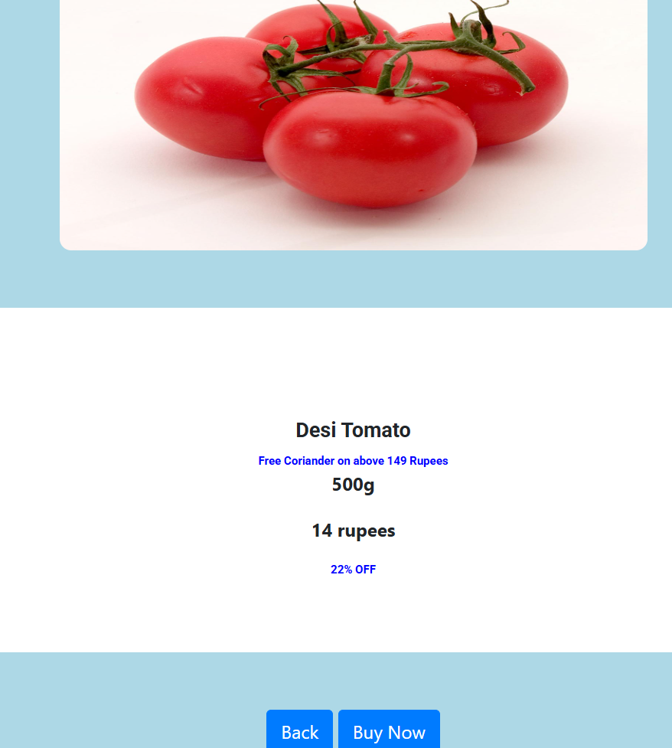
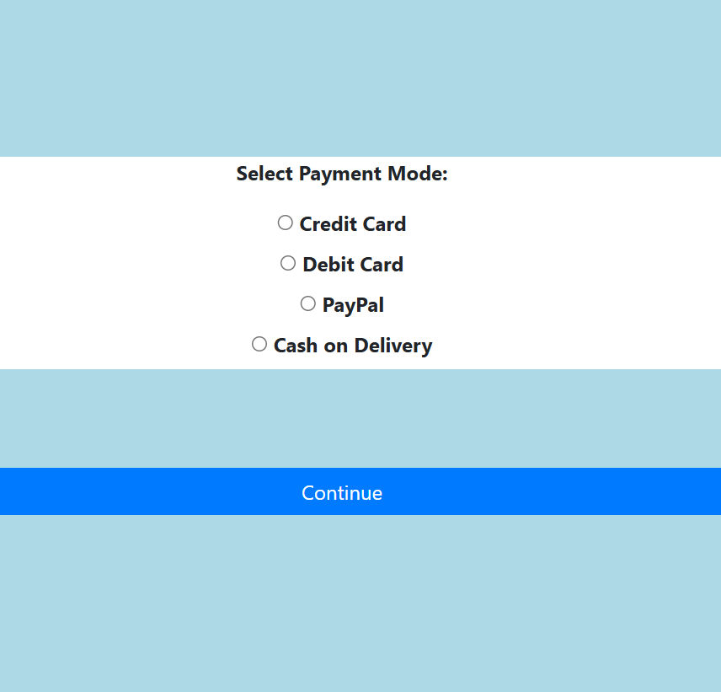

Slide 17
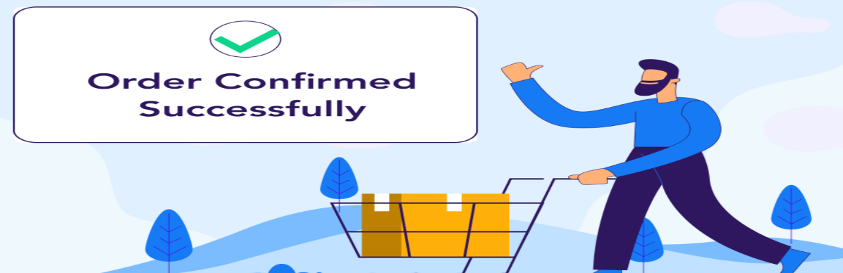

Slide 18
CONCLUSION:
The shift towards online grocery shopping is inevitable due to the increasing need for convenience and efficiency. Our online grocery store offers a seamless and customer-friendly platform to purchase daily essentials effortlessly. By integrating technology, we enhance user experience, ensure quality service, and provide a competitive advantage in the digital marketplace.
With a commitment to reliability, affordability, and innovation, our store aims to transform the grocery shopping experience for everyone.

Slide 19
References:
Chaffey, D. (2021). Digital Marketing: Strategy, Implementation, and Practice. Pearson Education. Available on Amazon.
• Laudon, K. C., & Traver, C. G. (2021). E-commerce: Business, Technology, and Society. Pearson Education. Available on Pearson.
•Statista. (2025). Global E-commerce Market Revenue. Retrieved from https://www.statista.com.
• Turban, E., Outland, J., King, D., Lee, J. K., Liang, T.-P., & Turban, D. C. (2021). Electronic Commerce 2021: A Managerial and Social Networks Perspective. Springer. Springer Link.
• World Economic Forum. (2023). The Future of E-commerce: Trends and Insights. Retrieved from https://www.weforum.org.
•Amazon Web Services. (2024). Building Scalable E-commerce Applications. Retrieved from https://aws.amazon.com/architecture.
Project Link: https://github.com/sagar28-kls/Grocery-shopping.git

Slide 20




Our fresh produce promise
LOCAL
FRESH
DELICIOUS
THANKYOU

